Slide 1


Gavin, JC, Vanessa

Slide 2
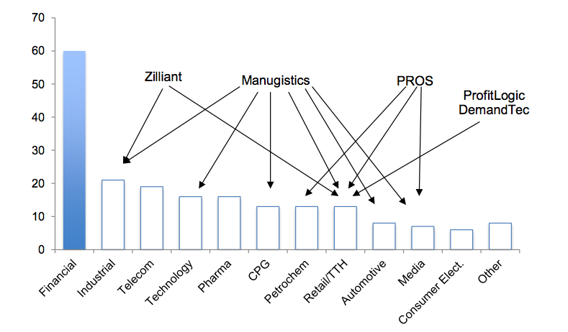
Introduction
Nomis offers pricing and revenue optimization
Leverage data science & analytics to determine best price to maximize profits
Potential to improve profitability at a wide range of financial service companies (ie auto-lending)
e-Car

Slide 3
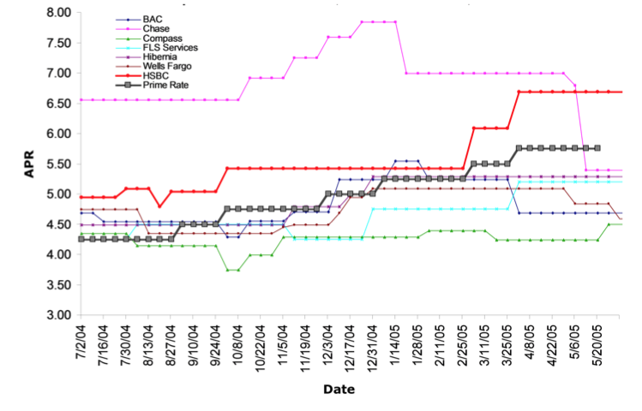
Problem — Reduced Profits
Currently e-Car does not employ a analytical approach to their auto loan pricing strategy
Additionally the auto loan market has high price dispersion
e-Car is potentially pricing at a suboptimal rate resulting in large reductions in profitability… we want to maximize profits!

Slide 4
Approach
EDA
Uncover insights in e-Car’s data
Segment the market
Use K-Means clustering to uncover customer segments and better tailor prices to individual customers
Maximize profit margins
Use a Decision Tree regressor to find the optimal price that balances profit margins and transaction volume

Slide 5
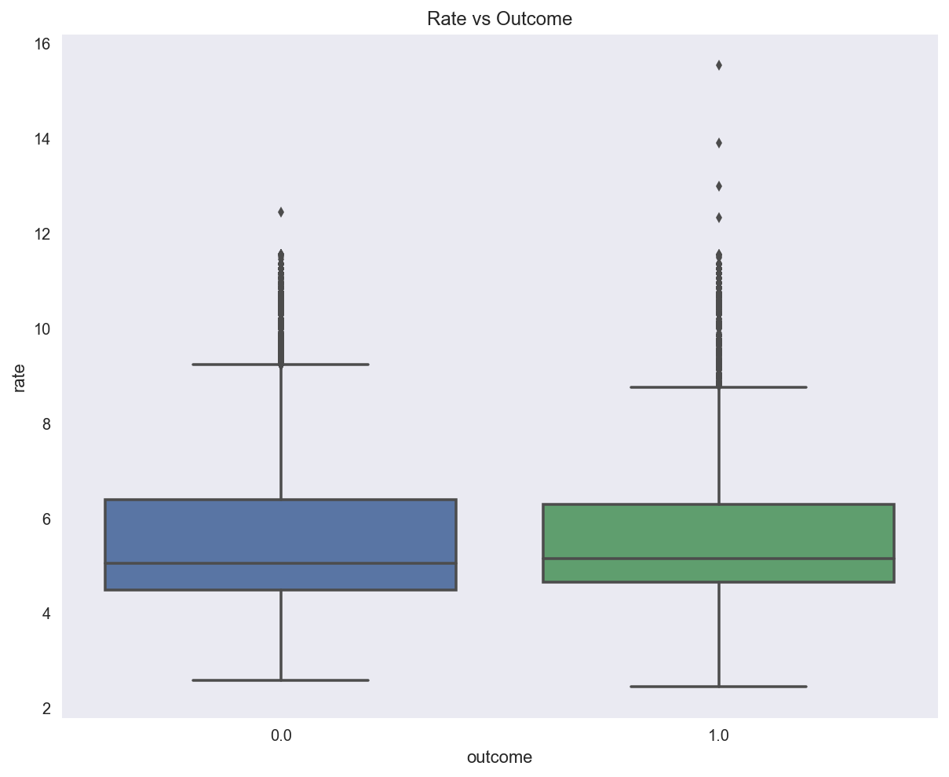
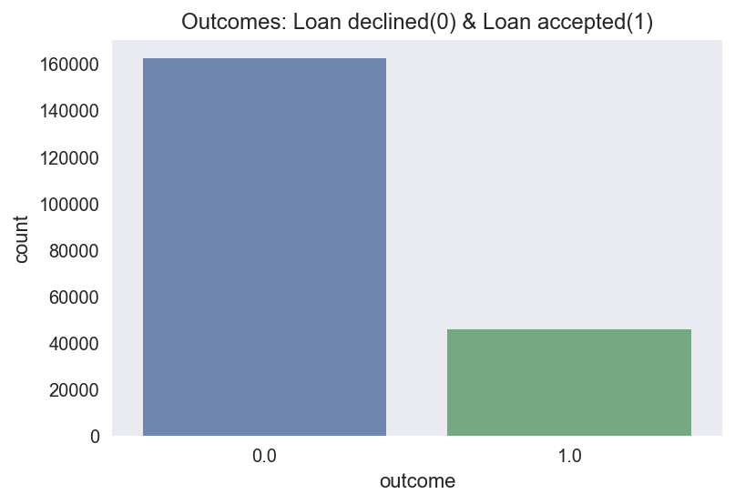
EDA — Loan acceptance
78% decline e-Car’s loan
22% accepted e-Car’s loan

Slide 6
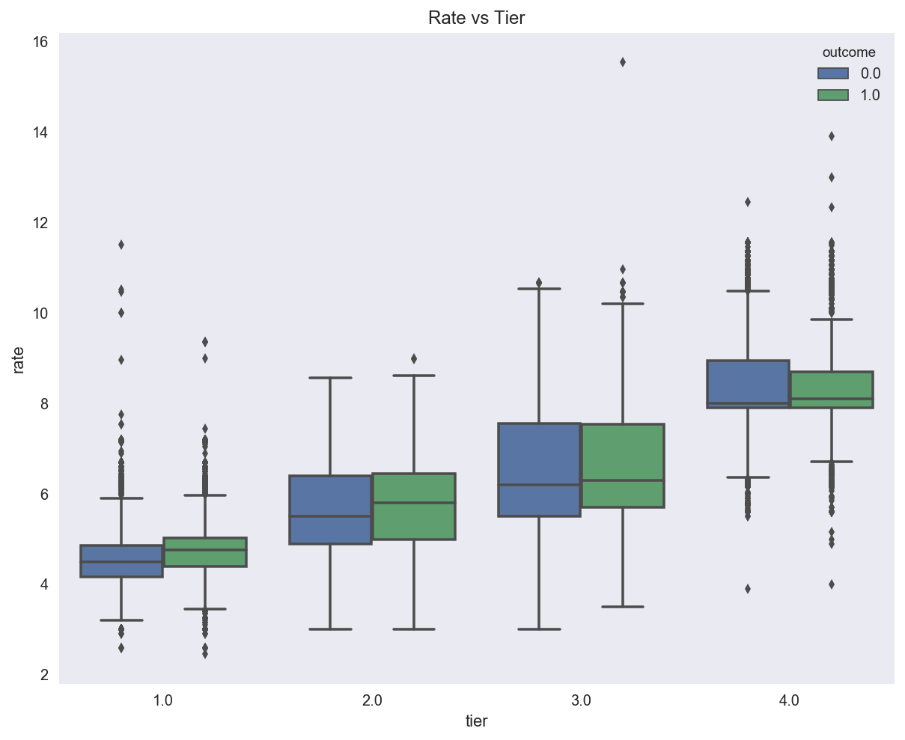
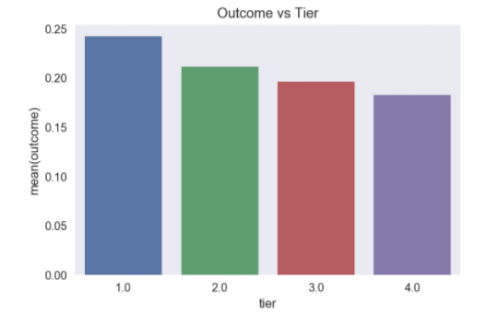
EDA — Rate vs Risk Tier
No big surprise here...
Higher risk customers are offered higher rates than lower risk customers

Slide 7
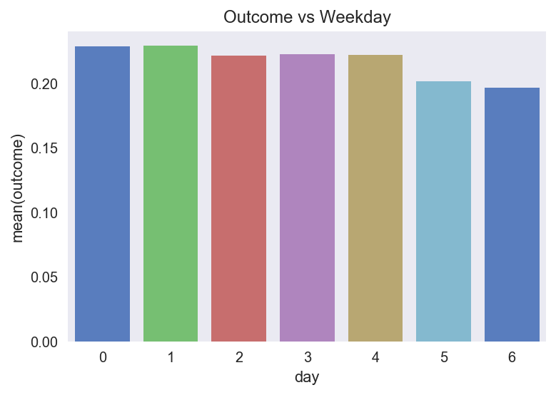
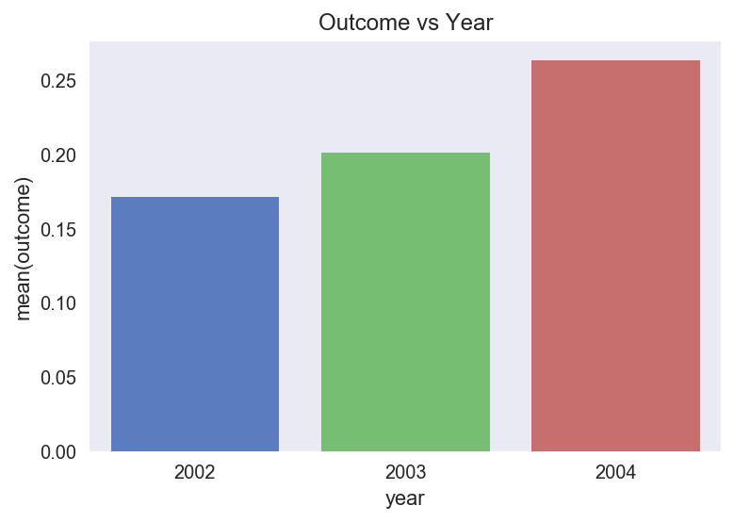
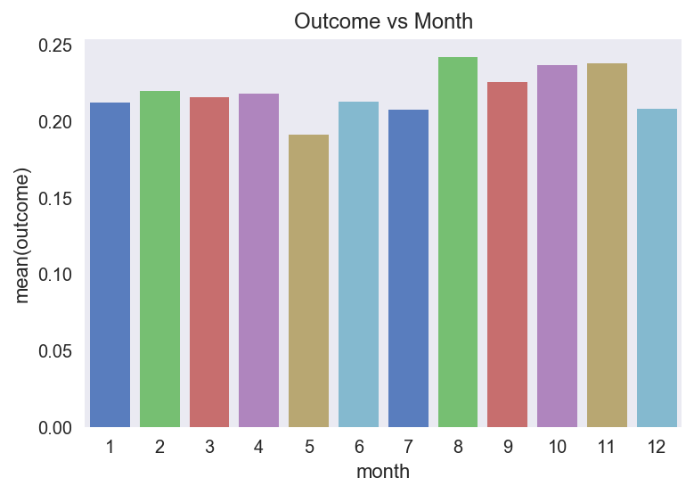
EDA — Time
August, October, November appear to be months with highest acceptance
Over 2002 – 2004 loan acceptance has Increased ~3% then ~5%

Slide 8
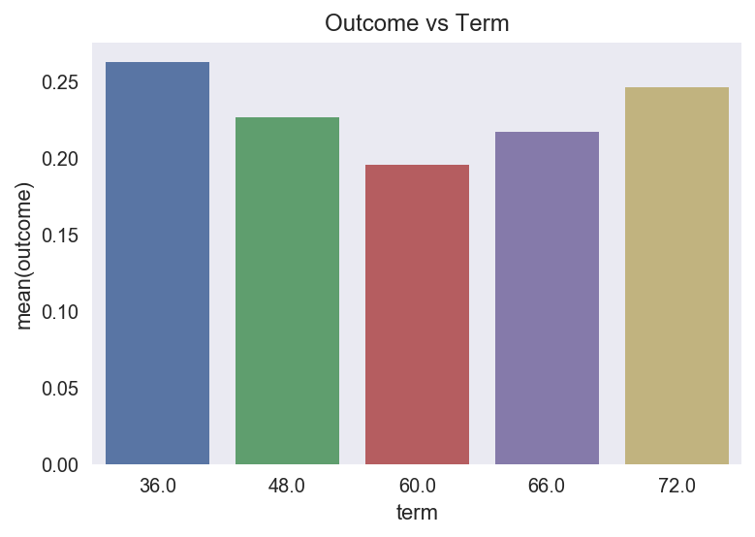
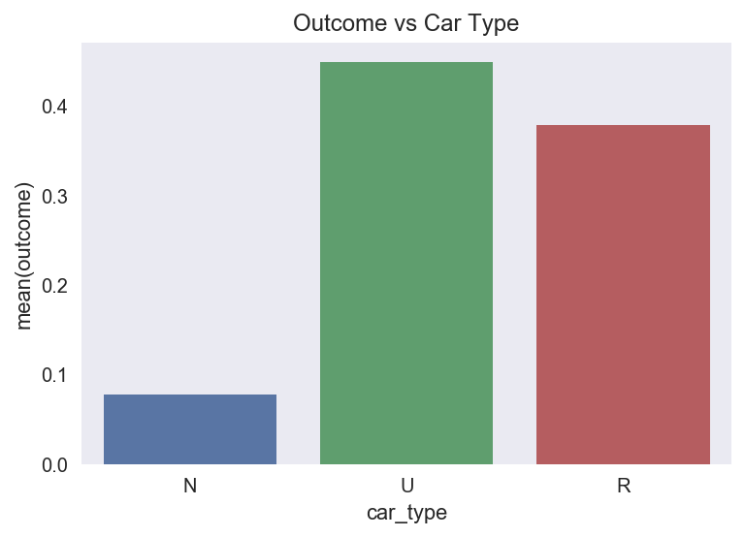
EDA — Term & Car Type
Not surprisingly customers seem to prefer short-term or long-term loans but not in between
Both Used and Refinance auto loans are associated with higher acceptance

Slide 9
Potential Profit
Being conservative and only analyzing tier 1 customers (those with the least amount of risk of loan default)
We observe that ~75 of tier 1 customers decline e-Car auto loans
Our estimates show that current profits are about on par with e-Car offering the average tier 1 rate to all of it’s tier 1 customers… we certainly can do better than simply the average!
This alone is very good evidence that an analytics backed pricing strategy can increase profits

Slide 10
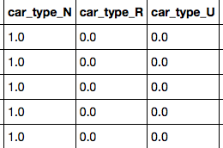

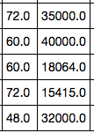
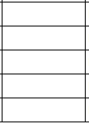

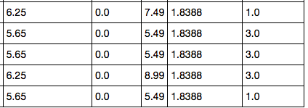

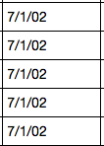

Data Cleaning - For Clustering

Slide 11
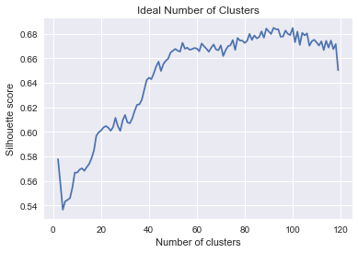
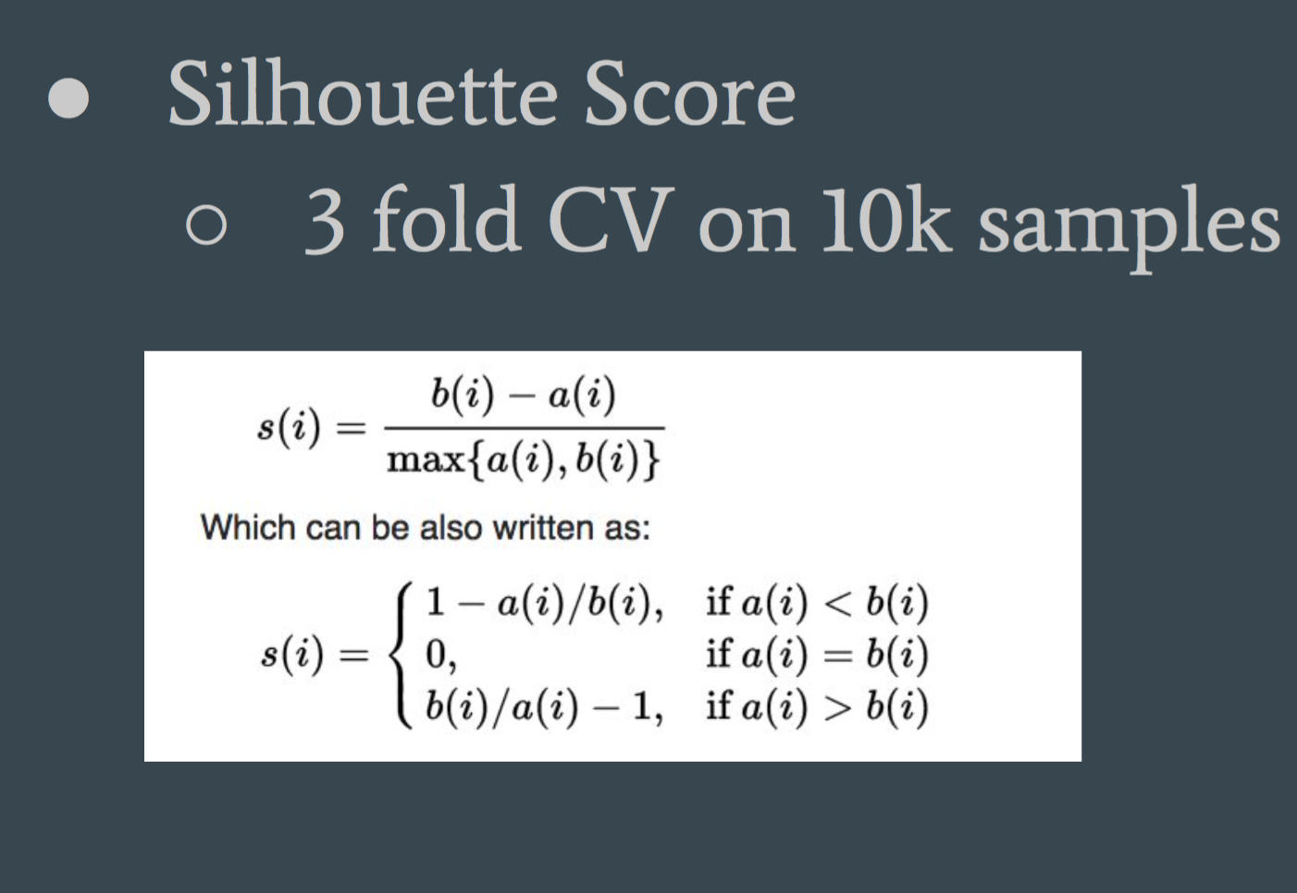
Clustering
Optimal Number of Clusters = 92

Slide 12
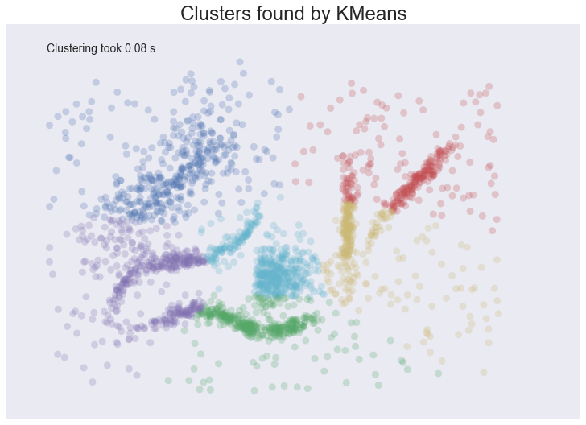
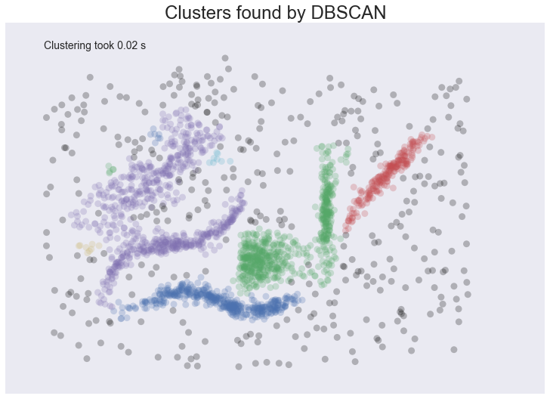
K-Means Vs DB Scan

Slide 13
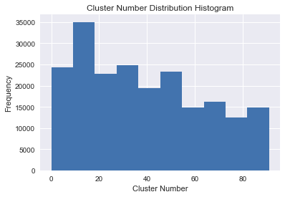
Clustering Distribution

Slide 14
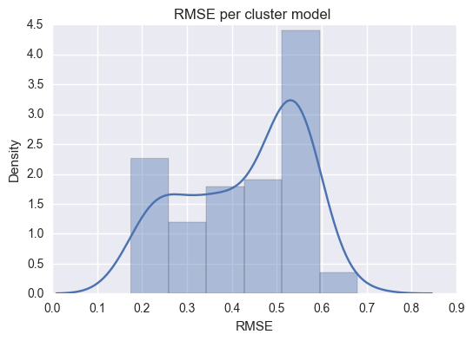
Logistic Regression - Predicted Rates RMSE

Slide 15
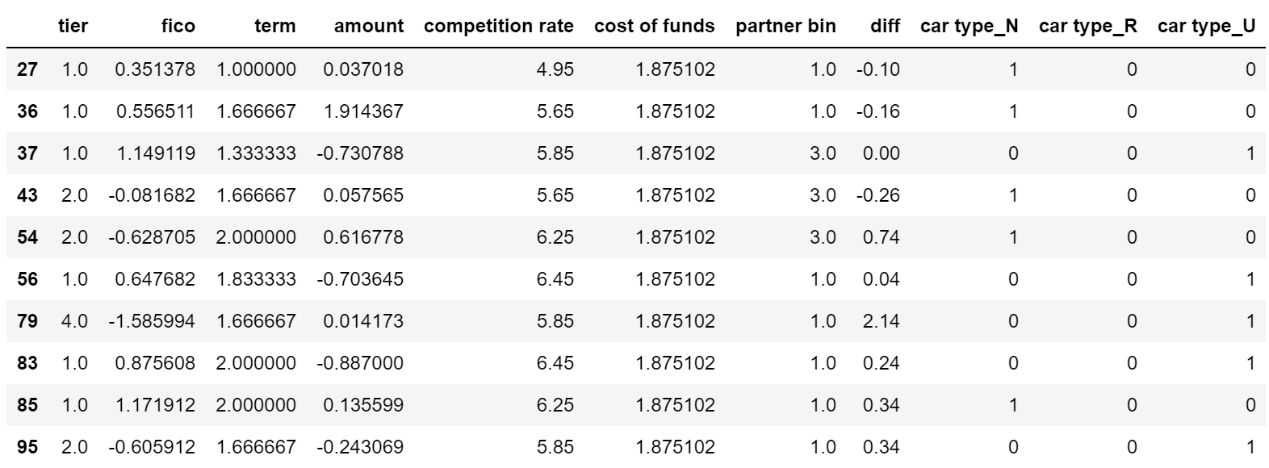
Model:
Decision Tree Regressor I

Slide 16
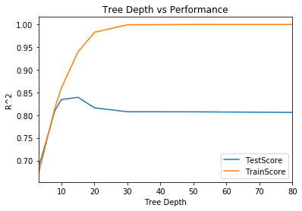
Decision Tree Regressor I

Slide 17
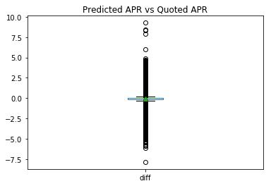
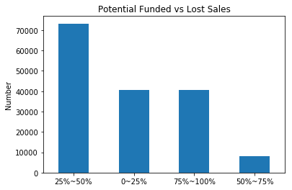
Decision Tree Regressor I

Slide 18
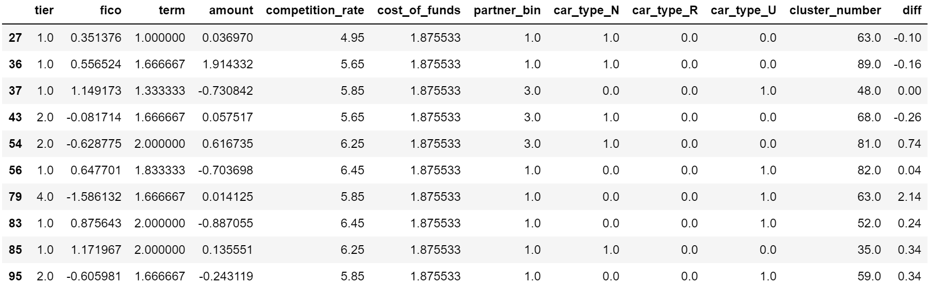
Decision Tree Regressor II

Slide 19
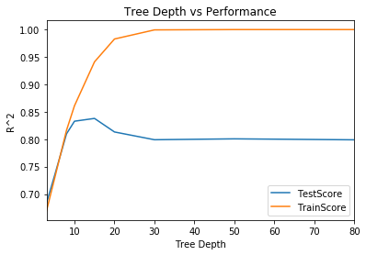
Decision Tree Regressor II
Without Clustering

Slide 20
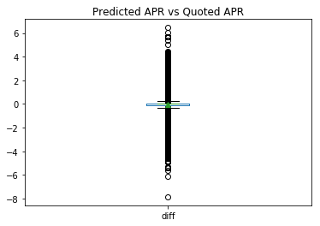
Decision Tree Regressor II
Without Clustering

Slide 21

Decision Tree Regressor II
Without Clustering

Slide 22
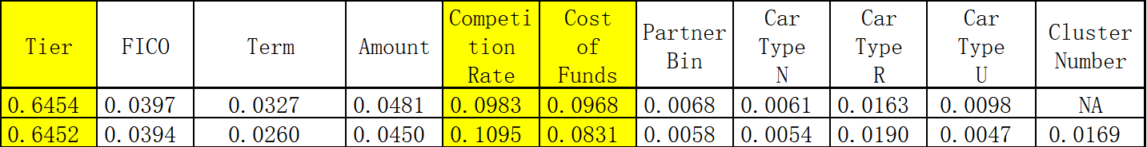
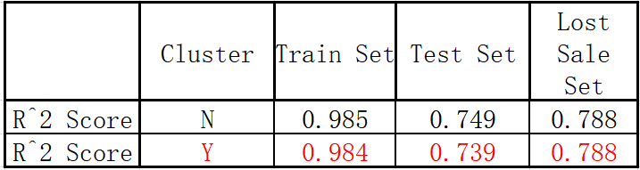
Model Conclusion
Feature Importance
Model Performance

Slide 23
Recommendations / Next Steps
Results indicates e-Car higher rates are causing customers to decline loans
Our recommendations:
Collect more data — for example customer demographics (salary, age, etc)
Principle Component analysis to find latent variables that best predict rate the maximum number of customers will accept
A/B or multi-armed bandit test pricing strategies

